Slide 1

BUSINESS DATA MANAGEMENT CAPSTONE PROJECT
Name-Amruta Joshi.
Roll no.- 21f1003797
I Indian Institute Of Technology Technology, Madras. Madras.
.

Slide 2


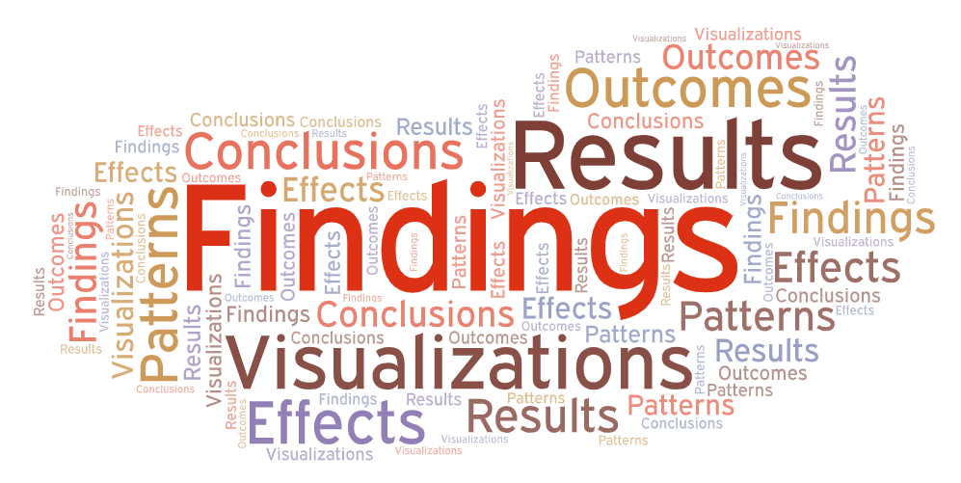


Steps taken to do project
Problem identification
Data collection
Data
Analysis
Results and findings
Recommendations

Slide 3
Business Overview
“Hotel Rajshreya”, is a hotel located on beach in Malvan,Sindhudurg,Maharashtra.
It is a B2C business .Local as well as tourists are customers of hotel.
It offers variety of dishes including authentic seafood thalis like Bangda thali,Kolambi thali and drink like Solkadhi.
It is owned by Mr.Prafulla.

Slide 4
Problem Statements
Which combo offers can be included in order to increase sales
Which new dishes should be added
Data collection
I discussed with owner , manager and other staff of hotel to know about their hotel .
Data was collected through hotel’s bill book and then total sales of each food item was entered in google sheet date wise for 1year
Survey was also taken among customers through gform

Slide 5
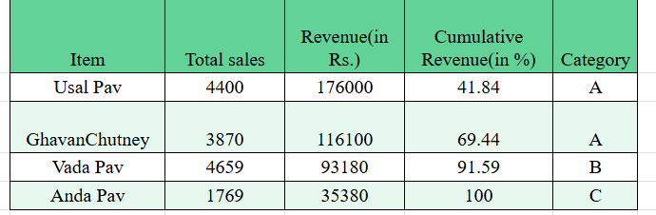
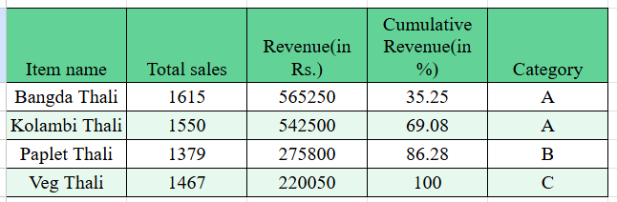
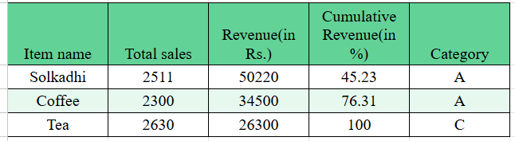
Data analysis
ABC Analysis
ABC analysis was done for each category based on revenue contribution to know how food items are performing.
In the case of breakfast items, although Vada-Pav is sold in more numbers than Usal-Pav and Ghavan Chutney, it contributes less in revenue. Usal Pav is top most in revenue generation, followed by Ghavan chutney. So, both of them got an A category and Vada Pav got a B category. Anda-Pav is very poor in terms of no. of units sold as well as revenue generation. So, it's included in the C category
In case of lunch menus,A category items are Bangada thali and Kolambi thali which creates more revenue and also sold more.B category item is Paplet thali .Although its no.of thalis are less sold than veg thali. It is because sea-food thalis are costlier.Veg thali got C Category.
In case of drinks, only two categories got assigned.Solkadhi and coffee both got A category and Tea got C category.Although ,Tea is most popular among drinks,it is classified as C based on its revenue.There is no B category because cumulative percentage directly jumped 100 .

Slide 6
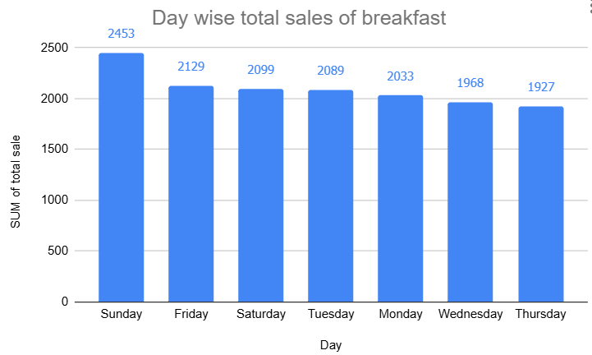
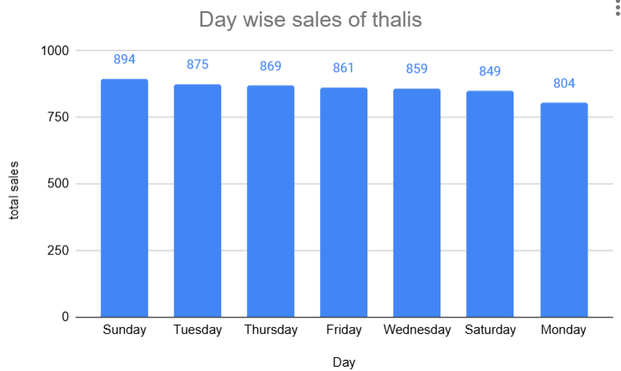
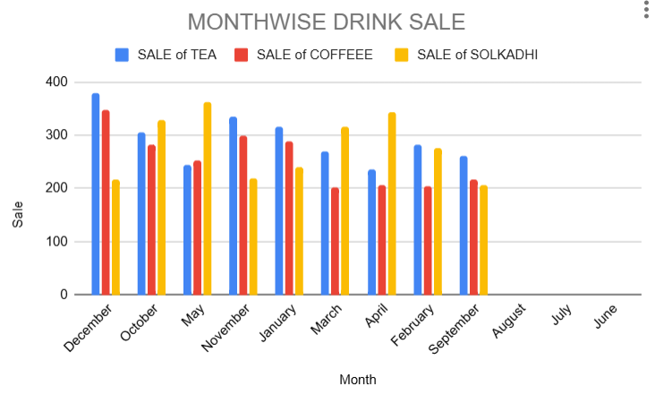
In case of breakfast items, overall sale is more on weekends are less during midweeks.
In case of thalis, less thalis are sold on Mondays.
In case of drinks,tea and coffee are more sold during winter and authentic cool drink Solkadhi is more sold in in summer .

Slide 7
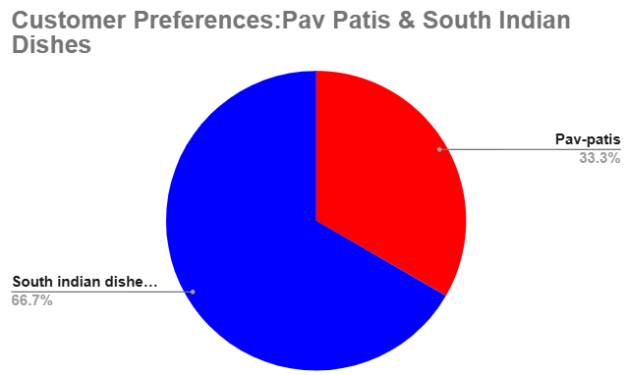
Survey Analysis
A survey was conducted among people to know what food item they like to added in menu.
It was observed that customers may like to have South Indian dishes like Idli-sambar,dosa etc. over Pav-patis.

Slide 8
Recommendations
Vada-Pav is fast-moving and popular, but it is not contributing at the top for revenue. Also, in the case of drinks, tea is fast-moving, but it is contributing least to revenue; both of them can be used to give a combo offer.
Usal-Pav and Ghavane chutney are authentic dishes of Malvan.Tourists are more interested in these kinds of dishes. These are special kokani foods. Although they are contributing more towards revenue generation, they are moderately moving. So, to attract more tourists, they can also be given as a combo offer with tea.
Anda-pav is the least sold breakfast item.It's not even close to other food items in terms of the number of units sold as well as revenue generation. It can be replaced with South Indian dishes such as idli sambar, dosa, etc.
In Malvan, tourists especially visit to taste fresh seafood dishes. Hotel Rajshreya is performing well in the case of Kolambi thali and Bangada thali. But it's moderately moving in the case of Paplet thali, although it's a seafood item. So, it can be given as a combo with the moderately moving drink Solkadhi, which is an authentic Malvani drink..

Slide 9
Although Veg Thali is performing well, it is not generating that much revenue as seafood-based thalis; it can also be given as a combo offer with Solkadhi. It cannot be removed or replaced considering the tastes of vegetarian people
Overall, for breakfast items, sales are less during midweek. So, combo offers can be offered on Thursdays or Wednesdays.
Overall, seabased thalis are less sold on Mondays because customers are preferring lighter meals. So, they can be offered with discounts or combos on Monday.
In the case of Solkadhi, it should be more promoted during summer months, like in April or May. Solkadhi is an authentic Malvani summer drink. From the data also, it's evident that customers are more inclined towards it during the summer season. So, in these months, it can be offered with a discount or as a combo with thalis in order to reach more customers.

Slide 10
Thank you.

